Slide 1
Session 2: Intro to Data Wrangling
Dan Killian and Ted Papalexopoulos
COS 2021

Slide 2
Many Thanks
Most of the material presented today was taken from, or inspired by, R for Data Science by Hadley Wickham and Garrett Grolemund
https://r4ds.had.co.nz/index.html

Slide 3
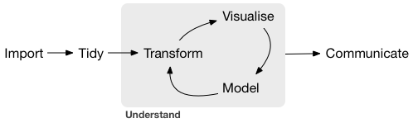
What do we, AS , do?
Data Scientists
Business Intelligence Analysts
Operations Researchers
Data Geeks
The Data Science Workflow
Share the results.
Get the data.
Structure the data.
Clean the data.
Create charts and figures.
Build models to predict.
Excel
R
R
R
Python
Julia

Slide 4
Today’s Goals
Introduce R and RStudio
R Basics
Introduce the Tidyverse
Practice Data Wrangling in R
My Hope
That you will leave this session with an appreciation for R’s utility and a clear idea of where to turn if you’d like to learn more.
I do not intend…
To make you R power-users in 2 hours.
To convince you that R is the one, true data science tool.

